Slide 1
Minerals and Ores as Resources

Slide 2
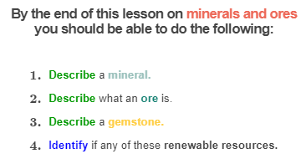
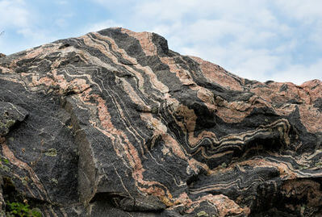

Slide 3
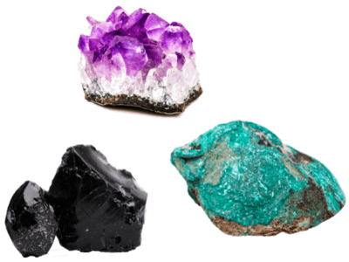
Rocks are made of minerals, which are formed as crystals cool.
Different minerals contain different natural resources.

Slide 4

Some minerals have lots of metal.
They provide the tin that cans are made from, the aluminium in cars and the copper in wires.

Slide 5
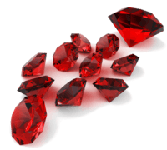
Other minerals are very hard and look pretty.
These are the gemstones used to make jewellery; they include diamonds and rubies!

Slide 6
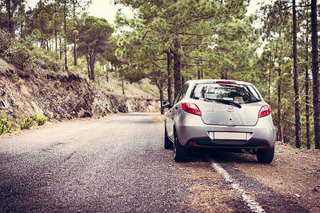
Rocks containing valuable minerals are called ores.
The ore bauxite is very rich in aluminium, which is used to make parts of vehicles like cars.

Slide 7
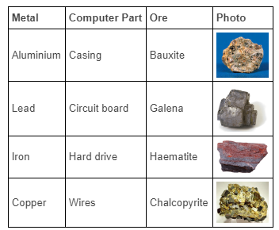
Here are some examples of ores and the metals we get out of them.

